Slide 1

Cultural Competency and Sensitivity Training

Slide 2
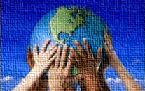
Cultural Competency

Slide 3
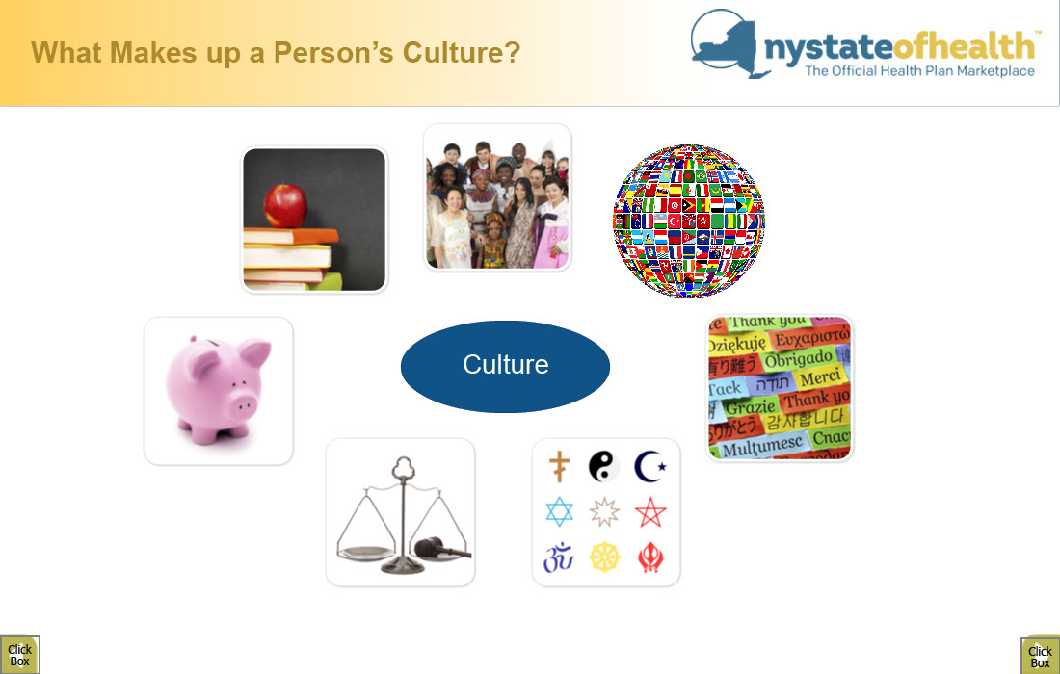
What Makes up a Person’s Culture?
Culture

Slide 4

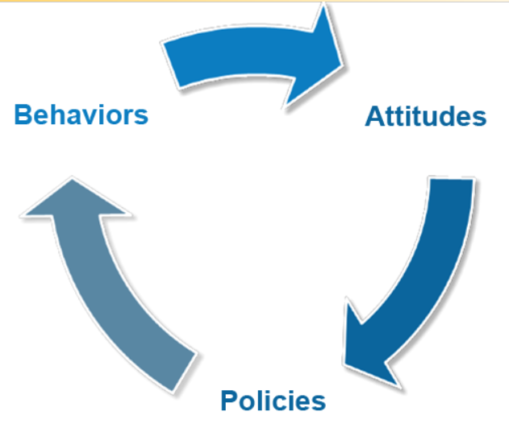



Defining Cultural Competence
Source: 2013 National Center for Cultural Competence. Excerpt from Cross, T.L., Bazron, B.J. Dennis, K.W., Issacs, M.R. & Benjamin M.P. Towards A Culturally Competent System of Care, (Vol 1). Washington, D.C. (1989).

Slide 5

When Services are Not Culturally Competent
When services do not meet the definition of cultural competence, consumers could experience
Feeling of being insulted or treated rudely.
Fear of contacting their LDSS or HRA office, NY State of Health, an Assistor or Facilitated Enroller, or a health plan.
Feeling confused and overwhelmed about health insurance.
Feeling unwelcome, unwanted and not valued.

Slide 6
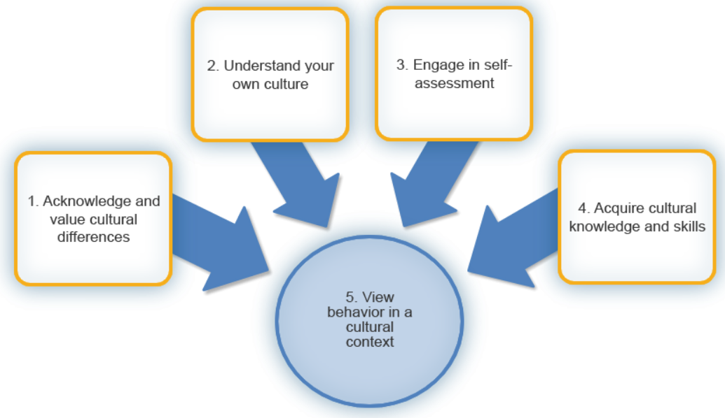
How to be Culturally Competent
Source: 2013 National Center for Cultural Competence. Excerpt from Cross, T.L., Bazron, B.J. Dennis, K.W., Issacs, M.R. & Benjamin M.P. Towards A Culturally Competent System of Care, (Vol 1). Washington, D.C. (1989).

Slide 7

Acknowledge and Value Cultural Differences
Ask about language preference
Offer services at convenient hours
Respect consumers’ decision-making processes
Provide facts to help consumers make decisions
Provide high quality services to all consumers
Source: excerpt from Conceptual Frameworks, Models, and Guiding Values and Principles.
National Center for Cultural Competence. Georgetown University. Retrieved on 6/27/13 from https://nccc.georgetown.edu/foundations/framework.php

Slide 8
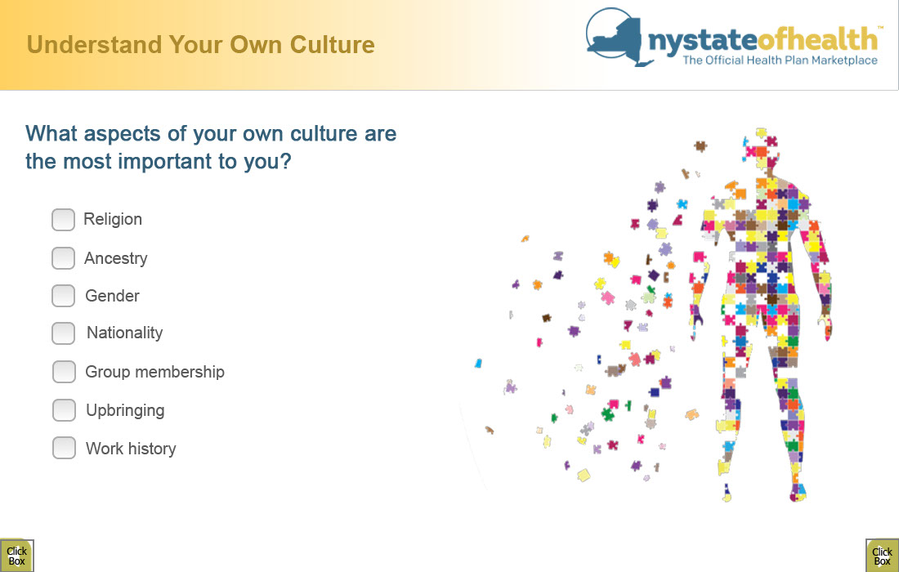
Understand your Own Culture
What aspects of your own culture are the most important to you?

Slide 9
Engage in Self-Assessment
What cultural experiences from your own life could affect how you communicate with a consumer who is from a different culture than your own?
What is one difference between you and consumers that could impact your ability to assist them to complete their enrollment in the Marketplace?
How can you respond effectively to that person and avoid a cultural collision?

Slide 10
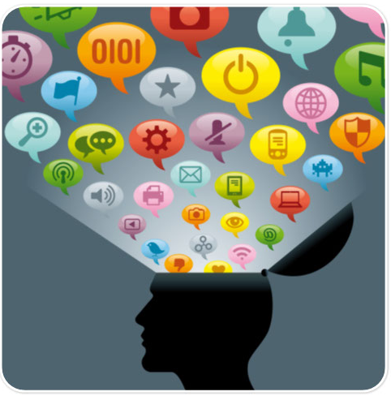
Acquire Cultural Knowledge
Basic knowledge of cultures can expand your awareness of diversity
Not everyone within a cultural group is the same - avoid stereotyping
Think about cultures that are prevalent in your area to develop your range of understanding

Slide 11
View Behavior in a Cultural Context
Acknowledging cultural differences
Understanding our own culture
Engaging in self-assessment
Acquiring cultural knowledge

Slide 12
How to be Culturally Competent
Source: 2013 National Center for Cultural Competence. Excerpt from Cross, T.L., Bazron, B.J. Dennis, K.W., Issacs, M.R. & Benjamin M.P. Towards A Culturally Competent System of Care, (Vol 1). Washington, D.C. (1989).

Slide 13
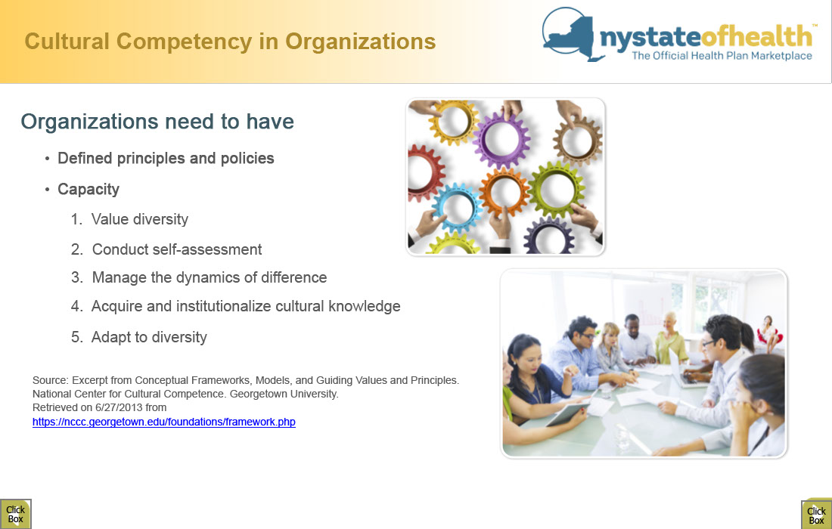
Cultural Competency in Organizations
Organizations need to have
Defined principles and policies
Capacity
Value diversity
Conduct self-assessment
Manage the dynamics of difference
Acquire and institutionalize cultural knowledge
Adapt to diversity
Source: excerpt from Conceptual Frameworks, Models, and Guiding Values and Principles.
National Center for Cultural Competence. Georgetown University. Retrieved on 6/27/13 from https://nccc.georgetown.edu/foundations/framework.php

Slide 14

History
As approved by New York State’s 2022 Enacted Budget and through an expansion of the Gender Expression Non-Discrimination Act, beginning in 2023, New Yorkers can update nearly all State forms with a gender-neutral ‘X’ (non-binary) designation.
As a result, the New York State Department of Health’s (NYSDOH’s) Bureau of Vital Records has adopted new procedures for capturing gender X (non-binary) on birth, death, and marriage records for events that occurred in New York State (NYS) outside of New York City.

Slide 15
History cont.
On January 9th, 2023, the New York State Department of Health announced the implementation of a non-binary option for birth, marriage, and death certificates for New Yorkers who reside outside of New York City, which maintains its own vital records.
In addition to "male" and "female" designating gender on the documents, there is now an "X" option to signify another gender or an undesignated gender for those who identify as non-binary.

Slide 16

Respecting the Consumer
Consumers want to feel valued and appreciated. They don’t want to be spoken down to or ignored. When you’re providing customer service, make sure you are respectful and use a polite and helpful tone.
Listening is one of the simplest ways to provide excellent customer service. Sometimes customers just need to be heard, so be sure to actively listen to what they have to say. They might have a valid point that you can use to make your product or service even better. By listening attentively, you can understand exactly what your customer needs from you.

Slide 17
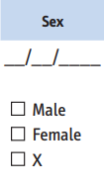
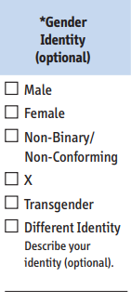
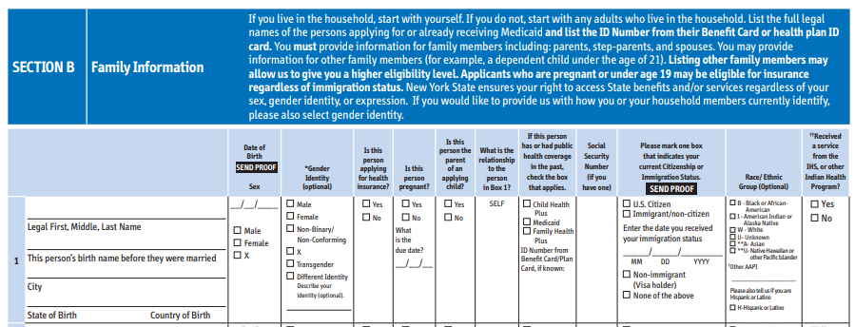
Access NY Application
Due to changes in state statute applicants now have the option to select ‘X’ along with ‘M’ (Male) and ‘F’ (Female) when entering their sex.
There is also an optional field for them to enter gender identity for themselves and their household members.

Slide 18
Welfare Management System (WMS)
While the Access NY application was updated with the option for X, there has been no update in the Welfare Management System (WMS) to accept the character of ‘X’.
To ensure access to certain services that are coded based on sex, individuals applying for Medicaid need to be informed that either an “M” or “F” variable is required in the “Sex” field to process the Medicaid application.
If the applicant answers that their sex is X, this selection will default to ‘F’ when the data is entered in WMS.
LDSS staff should not assume that an individual with sex “F” in WMS is female.
Districts should contact their local district Medicaid liaison for assistance if they are made aware of a Medicaid billing issue for a non-binary, intersex or transgender individual.

Slide 19
Avoid Making Assumptions
Don’t make assumptions about a non-binary or transgender person’s sexual orientation.
Gender identity is different than sexual orientation. Sexual orientation is about who we’re attracted to. Gender identity is about our own personal sense of being a man or a woman, or neither of those binary genders. Non-binary and transgender people can be gay, lesbian, bisexual, straight, or any other sexual orientation.
Do not make assumptions. Individuals who are non-binary or transgender can be married, divorced, have children, etc.
You can’t tell if someone is transgender just by looking.
Transgender people don’t look any certain way or come from any one background. Many transgender people do not appear “visibly trans,” meaning they are not perceived to be transgender by others. It is not possible to look around a room and “see” if there are any transgender people. You should assume that there may be transgender people at any gathering or in any space.
Tips for allies of transgender people. GLAAD. (2023, April 15). https://glaad.org/transgender/allies/

Slide 20
Avoid Making Assumptions cont.
If you don’t know what pronouns to use, listen first.
If you’re unsure which pronoun a person uses, listen first to the pronouns other people use when referring to them. Someone who knows the person well will probably use the correct pronoun. If you must ask which pronoun the person uses, start with your own. For example, “Hi, I’m Alex and I use the pronouns he and him. What about you?” Then use that person’s pronoun and encourage others to do so. If you accidently use the wrong pronoun, apologize quickly and sincerely, correct your mistake, then move on. The bigger deal you make out of the situation, the more uncomfortable it is for everyone.
Don’t ask a non-binary or transgender person what their “real name” is.
For some non-binary or transgender people, being associated with their birth name is a tremendous source of anxiety, or it is simply a part of their life they wish to leave behind. Respect the name a person is currently using. If you happen to know the name someone was given at birth but no longer uses, don’t share it without the person’s explicit permission.
Tips for allies of transgender people. GLAAD. (2023, April 15). https://glaad.org/transgender/allies/

Slide 21
Avoid Making Assumptions cont.
Be patient with a person who is questioning or exploring their gender identity.
A person who is questioning or exploring their gender identity may take some time to figure out what’s true for them. They might, for example, use a name or pronoun, and then decide at a later time to change the name or pronoun again. Do your best to be respectful and use the name and pronoun requested.
Be careful about confidentiality, disclosure, and “outing.”
Some non-binary and transgender people feel comfortable disclosing their gender history, while others do not. A person’s gender history is personal information and it is up to them to share it with others. Do not casually share this information, speculate, or gossip about a person. Not only is this an invasion of privacy, it also can have negative consequences in a world that is very intolerant of gender diversity. People can lose jobs, housing, friends, or even their lives when other people find out about their gender history.
Tips for allies of transgender people. GLAAD. (2023, April 15). https://glaad.org/transgender/allies/

Slide 22
Avoid Making Assumptions cont.
Respect the terminology a person uses to describe their identity.
People use many different terms to describe their experiences. Respect the term (transgender, transsexual, nonbinary, genderqueer etc.) a person uses to describe themselves. If a person is not sure which terms best describes their gender, give them the time to figure it out for themselves and don’t tell them which term you think they should use. You wouldn’t like your identity to be defined by others, so please allow others to define themselves.
Tips for allies of transgender people. GLAAD. (2023, April 15). https://glaad.org/transgender/allies/

Slide 23
Avoid Making Assumptions cont.
Avoid backhanded compliments and “helpful” tips.
While you may intend to be supportive, comments like the following can be hurtful or even insulting:
“I would have never known you were transgender. You look so pretty.”
“You look just like a real woman.”
“She’s so gorgeous, I would have never guessed she was transgender.”
“You’re so brave.”
“You’d pass so much better if you wore less/more make-up, had a better wig, etc.”
“Have you considered a voice coach?”
Tips for allies of transgender people. GLAAD. (2023, April 15). https://glaad.org/transgender/allies/

Slide 24

Can I select gender ‘X (non-binary)’ on my newborn’s NYS birth certificate?
Not at the time of the birth. State law requires that an original birth certificate, officially called the ‘Certificate of Birth,’ serve as medical documentation of a birth event. Therefore, the medically determined sex of the infant (male, female or intersex) by attending clinical personnel at the time of birth must be recorded.
While the medical determination of sex assigned at birth will remain on the original birth certificate, which will be sealed from release, a new birth certificate will be issued with the amended gender information located in the ‘sex’ field.
Source - Gender X FAQs

Slide 25
Who is eligible to request an amendment to gender designation on a NYS birth certificate?
Individuals 17 years or older can change their own gender designation on their birth certificate, including requests for ‘X (non-binary)’ gender designations. For minors (16 years or younger), the custodial parent(s) or legal guardian(s) of a minor named on the birth certificate can change the minor’s gender designation on the minor’s birth certificate, including requests for ‘X (non-binary)’ gender designations. The requesting parent(s)' or legal guardian(s)’ name must be on the birth certificate.
Source - Gender X FAQs

Slide 26

Additional Resources

Slide 27
Additional Resources
Resource | Description
LGBTQI+ Endorsement Program Standards | The LGBTQI+ Endorsement draft standards were created in an inter-disciplinary working group of experts that was convened by the New York City Anti-Violence Project (AVP) and OPDV.
The Need for LGBTQI+-Affirming Gender-Based Violence Services | Whitepaper outlining the need for inclusive and trauma informed gender-based violence services for LGBTQI+ survivors.
Gender-Based Violence Terminology | OPDV recognizes that language is important and ever evolving, particularly around experiences of violence, as well as intersectional identities & experiences. Please note that some of the terminology was identified with the assistance of the LGBTQI+ Endorsement Project Working Group.

Slide 28
Additional Resources
Resource | Population Focus | Description
NYC AVP | LGBTQI+ | Largest anti-LGBTQI+ violence organization in the country
In Our Own Voices, Inc. | LGBTQI+ BIPOC | Population specific agency that aims to address the needs of LGBTQI+ BIPOC
Centre Link | LGBTQI+ Resource | International nonprofit organization and member-based association of LGBTQI+ centers and other LGBTQI+ organizations serving their local and regional communities
Forge-Forward | TGNC | National transgender gender non-conforming agencies that provide training and technical assistance
Trans Lifeline | TGNC | Organization offering direct emotional and financial support to trans people in crisis – for the trans community, by the trans community.
Out & Equal | LGBTQI+ Employees | Organization working exclusively on LGBTQI+ workplace equality
Transgender Law Center | TGNC | National trans-led organization advocating for a world in which all people are free to define themselves and their futures.
National LGBT Task Force | LGBTQI+ | National organization that aims to increase access and equity for LGBTQI+ individuals
Office of Family Violence Prevention & Services Resource Centers | Training & Technical Assistance | Domestic Violence Resource Network (DVRN) is funded by the U.S. Department of Health and Human Services to inform and strengthen domestic violence intervention and prevention efforts at the individual, community, and societal levels.
Human Rights Campaign | LGBTQI+ | National organization that aims to increase access and equity for

Slide 29


